Slide 1
Benefits Of Aerial Work Platform That May Change Your Perspective

Slide 2
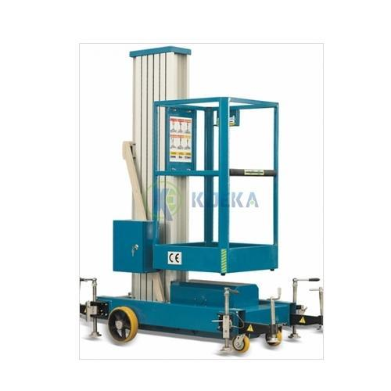
Benefits Of Aerial Work Platform That May Change Your Perspective

Slide 3
Benefits Of Aerial Work Platform That May Change Your Perspective
Aerial Work Platform are gaining high popularity in the in-house and temporary maintenance & construction applications due to the ability to work on low access levels.
They have low working heights compared to the boom & scissor lifts as they are utilized for lifting workers to limited heights in rooms & open spaces.
The low access platforms are increasingly being deployed as alternatives to the conventional ladders & scaffoldings to ensure labor safety and flexibility to work in confined spaces.

Slide 4
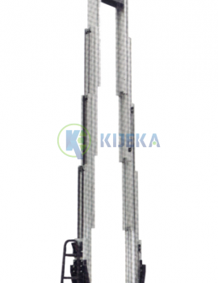
Benefits Of Aerial Work Platform That May Change Your Perspective

Slide 5
Benefits Of Aerial Work Platform That May Change Your Perspective
Additionally, due to compact design & less weight, the Aerial work Platform offer easy transportation and less assembly time, further supporting the AWP market expansion.
Aerial Work Platform offer exceptional stability with a patented aluminum mast system, heavy-duty lifting chains and welded steel base that stands up to rough jobsite conditions. Bottom line, they’re the ideal choice for big jobs in small spaces.

