Slide 1
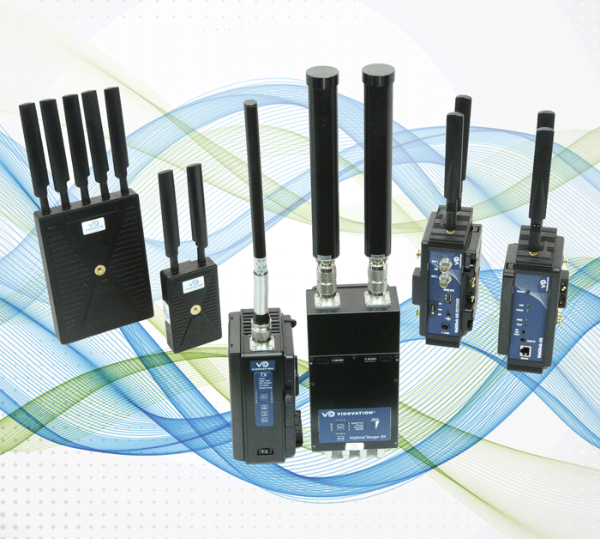
Wireless Video Transmitter And Receiver
End your frustrations with video transmission & distribution!
Wireless HD Video & Wireless Ethernet Transmitter and Receiver for Live Media Broadcast

Slide 2
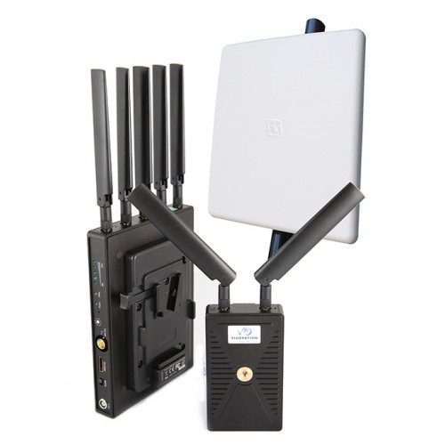
Wireless Video Transmitter
Wireless VidOlink Reacher, 5GHz, Zero Latency Link, up to 2000 Ft. LOS
Send broadcast-grade HDMI & HDSDI uncompressed video over the 5 GHz band. The VidOlink Reacher is our newest broadcast-grade HDMI and HD-SDI wireless video transmission link. The VidOlink Reacher is capable of reaching up to 2000 feet with zero latency and no compression.
The transmitter is very compact and lightweight ensuring exceptional maneuverability. This makes the unit ideal for video assist and on-set monitoring, news and sports broadcasts, UAV, military, corporate and other applications in which typical wireless systems either fall short on distance or are too high on price.

Slide 3
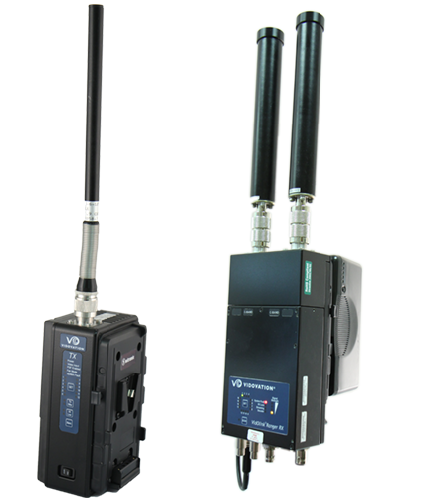
VidOvation Video Transmission
Wireless VidOlink Ranger, COFDM Link, up to 1 Mile LOS
The VidOlink Ranger is available in 2GHz, 5.8GHz, and 7GHz bands with mounts for Anton Bauer, V-lock and, Hot-Shoe. The VidOlink Ranger is a highly portable broadcast grade MPEG 4 COFDM HD wireless camera transmission link capable of providing high-quality at distances up to 2-miles line of sight.
Demanding videographers choose the VidOlink Ranger when they require the highest quality video without breakup or pixilation. The VidOlink Ranger comes in a portable package and is designed to give the operator the ability to set up quickly and cover wide areas with long range wireless transmission.

Slide 4
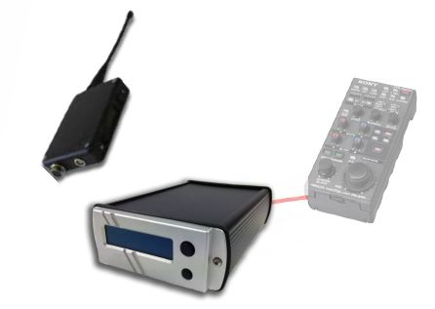
VidOvation Video Distribution
New: Wireless VidOlink Tally and Control
The newly released VidOlink Tally & Control system delivers spectacular performance. While you are moving your HD SDI or HDMI video signals over a VidOlink Reacher or VidOlink Ranger, add this unit for the extra features of tally and camera control functions like RB Gain, Iris, A Iris mode, M Ped, Gain, Shutter, Bars, CC Filter select, ND Filter select, AWB, ABB, etc.
The VidOlink Tally & Control has options for Sony, Panasonic, Ikegami, Thomson and Hitachi cameras. Brackets are available to secure the unit. Additonally, data can also be sent down our RF over fiber SMPTE units so with just one cable you can have RF, Data and power to your receive point.

Slide 5
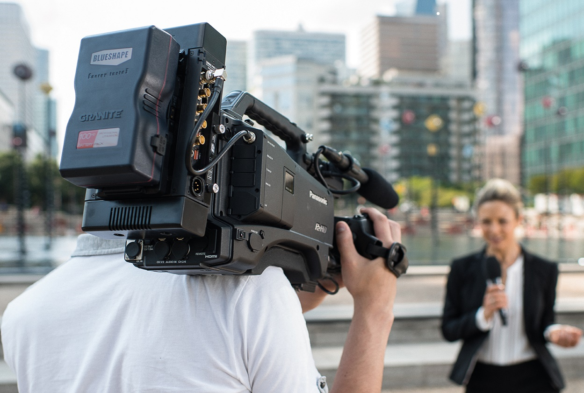
IPTV
VidOvation Enterprise IPTV is a turnkey flexible and scalable Enterprise IPTV solution that empowers organizations to incorporate live TV programs, live internal video broadcast and video-on-demand to increase the efficiency of training and communications. VidOvation Enterprise IPTV delivers digital television programming to employee's PC's, TV's, Smartphones and Tablets, allows scheduled recording via program guide on PC's, and provides such recorded content for on-demand time-shift viewing.

Slide 6
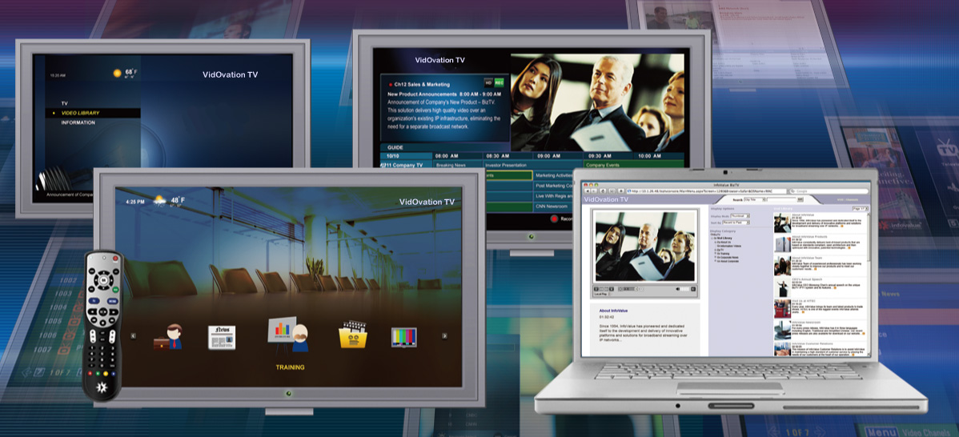
IPTV Sharing
The VidOvation Enterprise IPTV system fully integrates with the DirecTV COM2000 Satellite for Enterprise, the Dish Network SmartBox, Cable Television and more.
Internet Protocol television (IPTV) is a system through which television services are delivered using the Internet protocol suite over a packet-switched enterprise network , instead of being delivered through traditional RF coax. IPTV is very cost-effective, flexible, and highly interactive

Slide 7
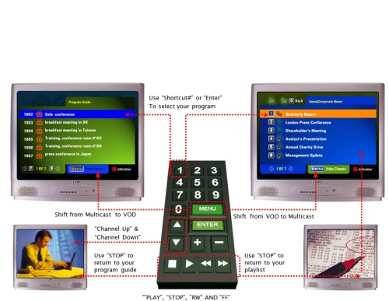
Vidovation Corporation
Encompassing wireless video, bonded cellular, video streaming, video networking, IPTV, and fiber optic communications systems, VidOvation solutions improve video transmissions by removing the frustrations of dropouts, latency, interference, noise, and security issues.
VidOvation excels in helping its clients integrate custom solutions into existing infrastructure, with the ability to meet almost any application or budget. The company applies proven expertise on the complete project lifecycle — from project consulting and management to engineering and design, to warranty and support.

Slide 8
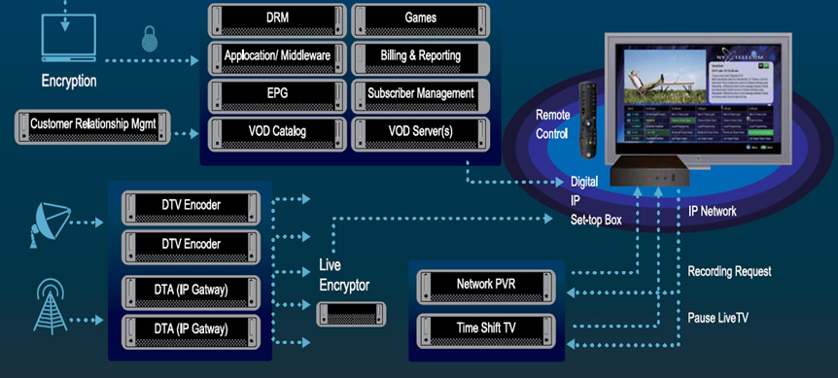
Wireless Video
VidOvation In-house Enterprise IPTV video networking systems deliver a flexible and scalable distribution of video and live television over your enterprise, corporate, or facility network. We are the only vendor capable of additionally streaming to computer desktops, smartphones, tablets, displays, Smart TVs and set-top boxes.

Slide 9
VidOvation Video Transmission
The system supports Live TV content from DirecTV, Dish Networks, Satellite, Cable and more. VidOvation TV allows businesses or facilities to have their internal TV channels to communicate, train and guide employees, including appropriate instructions during critical emergency situations. We ensure powerful and easy-to-use functions, high-quality video, reliable and well-managed operations, and unparalleled scalability and extensibility.

Slide 10





Wireless Video Transmitter And Receiver
For more information visit our website:
www.vidovation.com

